Slide 1


APEX INSTITUTE OF TECHNOLOGY
DEPARTMENT OF COMPUTER SCIENCE & ENGINEERING
MACHINE LEARNING (21CSH-286)
Faculty: Prof. (Dr.) Vineet Mehan (E13038)
Lecture - 2
Introduction to Machine Learning
DISCOVER . LEARN . EMPOWER

Slide 2
DBMS: Course Objectives
COURSE OBJECTIVES
The Course aims to:
Understand and apply various data handling and visualization techniques.
Understand about some basic learning algorithms and techniques and their applications, as well as general questions related to analysing and handling large data sets.
To develop skills of supervised and unsupervised learning techniques and implementation of these to solve real life problems.
To develop basic knowledge on the machine techniques to build an intellectual machine for making decisions behalf of humans.
To develop skills for selecting suitable model parameters and apply them for designing optimized machine learning applications.

Slide 3
COURSE OUTCOMES
On completion of this course, the students shall be able to:-
CO1 | Understand machine learning techniques and computing environment that are suitable for the applications under consideration.

Slide 4
Unit-1 Syllabus
Unit-1 | Introduction to Machine Learning
Introduction to Machine Learning | Definition of Machine Learning, Working principles of Machine Learning; Classification of Machine Learning algorithms: Supervised Learning, Unsupervised Learning, Reinforcement Learning, Semi-Supervised Learning; Applications of Machine Learning.
Data Pre-Processing and Feature Extraction | Data Sourcing and Cleaning, Handling Missing data, Encoding Categorical data, Feature Scaling, Handling Time Series data; Feature Selection techniques, Data Transformation, Normalization, Dimensionality reduction
Data Visualization | Data Frame Basics, Different types of analysis, Different types of plots, Plotting fundamentals using Matplotlib, Plotting Data Distributions using Seaborn.

Slide 5
SUGGESTIVE READINGS
TEXT BOOKS:
There is no single textbook covering the material presented in this course. Here is a list of books recommended for further reading in connection with the material presented:
T1: Tom.M.Mitchell, “Machine Learning, McGraw Hill International Edition”.
T2: Ethern Alpaydin,” Introduction to Machine Learning. Eastern Economy Edition, Prentice Hall of India, 2005”.
T3: Andreas C. Miller, Sarah Guido, Introduction to Machine Learning with Python, O’REILLY (2001).
REFERENCE BOOKS:
R1 Sebastian Raschka, Vahid Mirjalili, Python Machine Learning, (2014)
R2 Richard O. Duda, Peter E. Hart, David G. Stork, “Pattern Classification, Wiley, 2nd Edition”.
R3 Christopher Bishop, “Pattern Recognition and Machine Learning, illustrated Edition, Springer, 2006”.

Slide 6
Introduction to Machine Learning
Humans learn from experiences.
Whatever we learn from experiences(Good or Bad) we try to implement/perform action correspondingly.
Example: Driving a Car
Initially we learn how to drive
Then we drive
& then we become expert

Slide 7
Introduction to Machine Learning
Similarly machines also learn
From where machines learn?
Machines learn from data.
More the data 🡪 better will be the model 🡪 higher will be the accuracy. (Just like the more you drive 🡪 the more better you become a driver)

Slide 8
Introduction to Machine Learning
ML is a branch of AI.
Learning means
Acquiring Knowledge
Behavior Skills
Understanding
Synthesizing different information
Ability to learn is possessed by humans, animals etc. and now this ability to learn is extended to machines.

Slide 9
Definition
ML is a scientific discipline that is concerned with design and development of algorithms that allows computers to change behaviors based on data.

Slide 10
Introduction to Machine Learning
Major focus of ML 🡪 to automatically learn to recognize complex patterns
And to make intelligent decisions based on the data.
It is for the above reason that ML is closely related to the following areas:
1. Statistics

Slide 11
Introduction to Machine Learning
Probability Theory
AI
Theoretical Computer Science
Data Mining
Pattern Recognition

Slide 12
Types of Machine Learning
Supervised Learning
Unsupervised Learning
Semi-Supervised Learning
Reinforcement Learning

Slide 13
1. Supervised Learning
So when new weight is entered in to the model, machine can predict the currency
Such a model where labeled data is used for learning is called Supervised Learning.
Lets say there are 2 friends
One friend gives 1 million coins(10 Lakhs) to the another of 3 different currencies.
One Rupee
One Dollar
One Pound
Currencies
So, on the basis of weights Machine can predict the currency of the coin.
Weights
4 Grams
Weights = Feature
9 Grams
Currency = Label
3 Grams
When data is fed to the machine it learns that which feature is associated with which label.

Slide 14
1. Supervised Learning
In supervised learning, we use known or labeled data for the training data.
Since the data is known, the learning is, therefore, supervised, i.e., directed into successful execution.
The input data goes through the Machine Learning algorithm and is used to train the model.
Once the model is trained based on the known data, you can use unknown data into the model and get a new response.

Slide 15
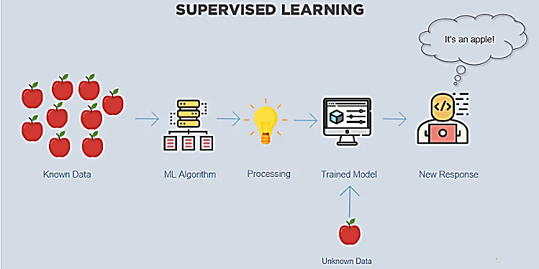
1. Supervised Learning

Slide 16
Algorithms used for Supervised Learning
Polynomial regression
Random forest
Linear regression
Logistic regression
Decision trees
K-nearest neighbors
Naive Bayes

Slide 17
2. Unsupervised Learning
Lets say we have a cricket dataset of various players with the respective scores and wickets taken.
This data is feed into the ML model.
Machine identifies the performance of players.
It plots a graph with x axis and y axis.

Slide 18
2. Unsupervised Learning
Wickets | Runs
1 | 100
1 | 90
2 | 85
1 | 75
1 | 120
4 | 30
5 | 40
3 | 24
6 | 29
4 | 42

Slide 19
2. Unsupervised Learning
Interpretation is : Data is of Batsman
It shows players that have scored more runs and taken less wickets
Cluster 1
Cluster 2
It shows players that have scored less runs and taken more wickets
Interpretation is : Data is of Bowlers
Important Point is: Initially there were no labels of batsman and bowlers
No Labeled Data
Learning with
No Labeled Data is Unsupervised Learning

Slide 20
2. Unsupervised Learning
In unsupervised learning, the training data is unknown and unlabeled - meaning that no one has looked at the data before.
Without the aspect of known data, the input cannot be guided to the algorithm, which is where the unsupervised term originates from.
This data is fed to the Machine Learning algorithm and is used to train the model.
The trained model tries to search for a pattern and give the desired response.

Slide 21
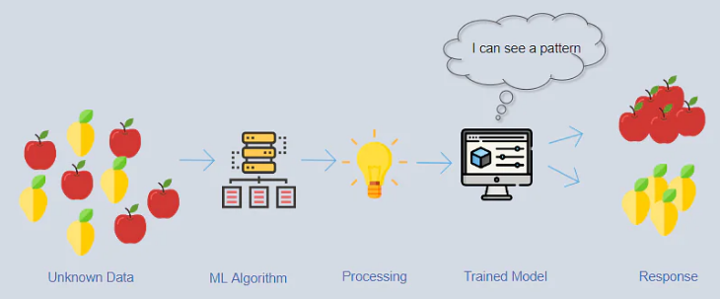
2. Unsupervised Learning

Slide 22
3. Semi-Supervised Learning
In this learning is obtained both from the supervised learning and unsupervised learning.
Labeled Data
Unlabeled Data
Expensive to Obtain
Cheap to Obtain
ML Researchers 🡪 use Labeled data + Unlabeled data in conjunction 🡪it improves learning accuracy

Slide 23
Algorithms used for Unsupervised Learning
Partial least squares
Fuzzy means
Singular value decomposition
K-means clustering
Apriori
Hierarchical clustering
Principal component analysis

Slide 24
4. Reinforcement Learning
Let’s say we have an image of a dog.
Image is fed into the model.
Model task is to identify that it is a dog.
If model identifies it to be a dog then a positive response is there.
If model identifies it to be a cat then a negative response is there.

Slide 25
4. Reinforcement Learning
Now machine learns from the feedback.
If any other image of dog comes at a later time then the model will be able to classify it correctly.

Slide 26
4. Reinforcement Learning
Reinforcement Learning is a feedback-based Machine learning technique.
In Reinforcement Learning an agent learns to behave in an environment by performing the actions and seeing the results of actions.
For each good action, the agent gets positive feedback, and for each bad action, the agent gets negative feedback or penalty.

Slide 27
4. Reinforcement Learning
In Reinforcement Learning, the agent learns automatically using feedbacks without any labeled data, unlike supervised learning.
Since there is no labeled data, so the agent is bound to learn by its experience only.
Like traditional types of data analysis, here, the algorithm discovers data through a process of trial and error and then decides what action results in higher rewards.

Slide 28

Generalized Machine Learning Model
Model
Inputs
Outputs
If output is right then take the output as final result. Else
Feedback is given to the model to predict until it learns.

Slide 29
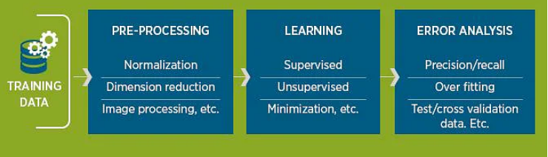

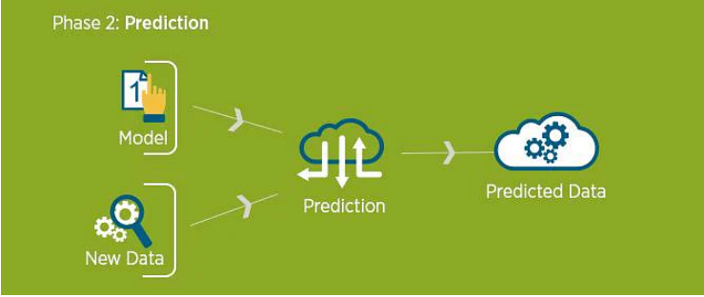
Fig: Machine Learning Process

Slide 30
Task: Scenario-1
Facebook recognizes your friend in a picture from an album of tagged photographs.
Decide that it is Supervised/Unsupervised/ Reinforcement Learning and support your answer with a suitable reason (BT-Level5)

Slide 31
Task: Scenario-2
Netflix recommends a new movie based on the past movie choices.
Decide that it is Supervised/Unsupervised/ Reinforcement Learning and support your answer with a suitable reason (BT-Level5)

Slide 32
Task: Scenario-3
Analyzing bank data for suspicious transactions and flagging fraud transactions.
Decide that it is Supervised/Unsupervised/ Reinforcement Learning and support your answer with a suitable reason (BT-Level5)

Slide 33
Summary
Introduction
Types of Machine Learning
Examples
Machine Learning Process

Slide 34
REFERENCES
https://www.javatpoint.com/machine-learning
https://www.tutorialspoint.com/machine_learning/index.htm
https://www.simplilearn.com/tutorials/machine-learning-tutorial/what-is-machine-learning?source=sl_frs_nav_playlist_video_clicked

Slide 35

THANK YOU
For queries
Email: vineet.e13038@cumail.in

